Slide 1



Digital
Games
Game Design - 201
Tue 2-4:45pm C-356
Prof. A McClure

Slide 2
INTRODUCTIONS

Slide 3

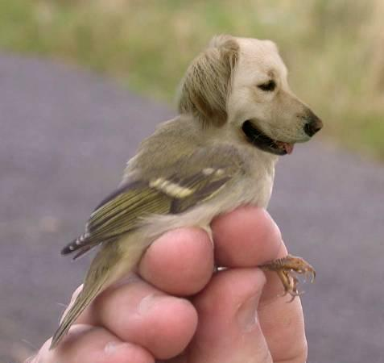
Name?
What do you want out of this class?
Favorite childhood game?
Animal that could fit inside a 2 liter bottle?

Slide 4
SYLLABUS
hostos-gd201.tumblr.com

Slide 5
DI.GI.TAL
Notes:
digital, mechanism, computational, compute,

Slide 6
DIG.IT.AL
(of signals or data) expressed as series of the digits 0 and 1, typically represented by values of a physical quantity such as voltage or magnetic polarization.

Slide 7
calculation
vs
computation
Notes:
digital, mechanism, computational, compute,

Slide 8

mechanization of imagination
Notes:
Mechanization or mechanisation (BE) is the process of changing from working largely or exclusively by hand or with animals to doing that work with machinery.

Slide 9

making the abstract tangible

Slide 10
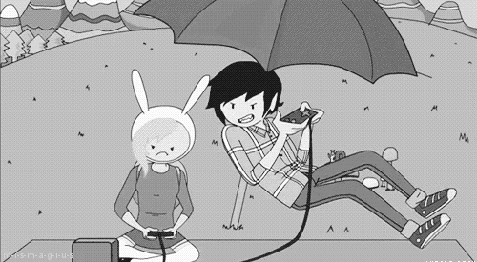
Why are games suited to being digital?

Slide 11
First Video Game?

Slide 12
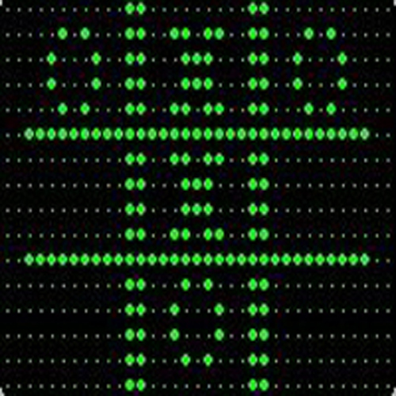
OXO
“noughts and crosses”
Prof. Alexander Sandy Douglas
1952
Programming on an EDSAC (Electronic Delay Storage Automatic Calculator) at University of Cambridge, England

Slide 13
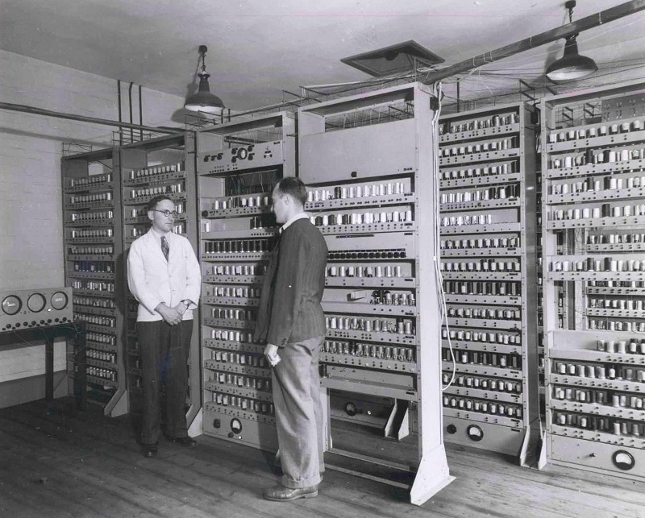

Slide 14
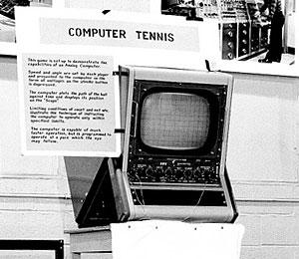
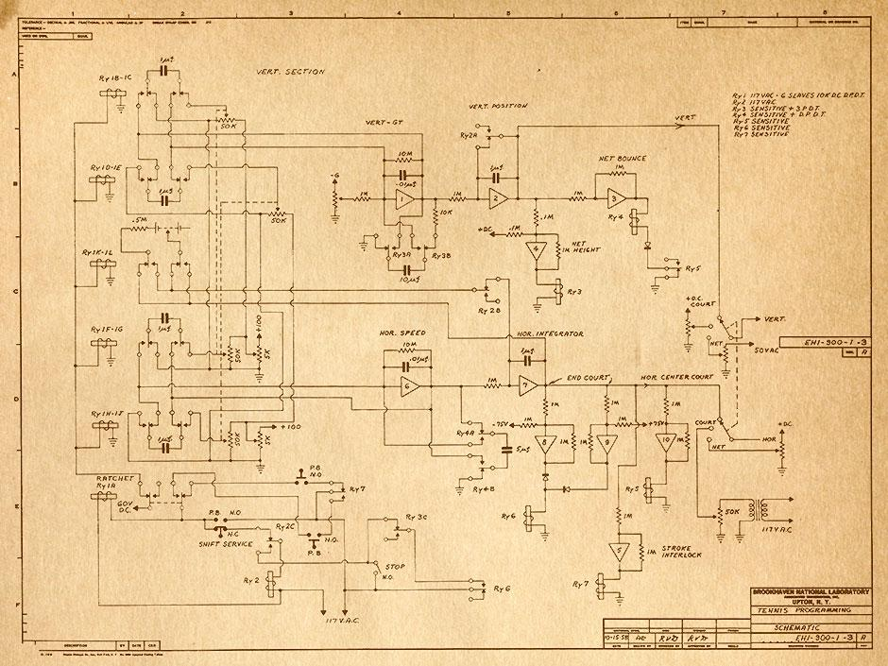
Tennis for Two
William Higinbothan
1958
Programming on a Donner Model 30 at Brookhaven National Lab
video
link

Slide 15
History of Video Games Part 1
Steve Russell, Computer Space, etc.
link

Slide 16
Coin Operated Machines

Slide 17

1931
First coin-op Pinball

Slide 18

1966

Slide 19
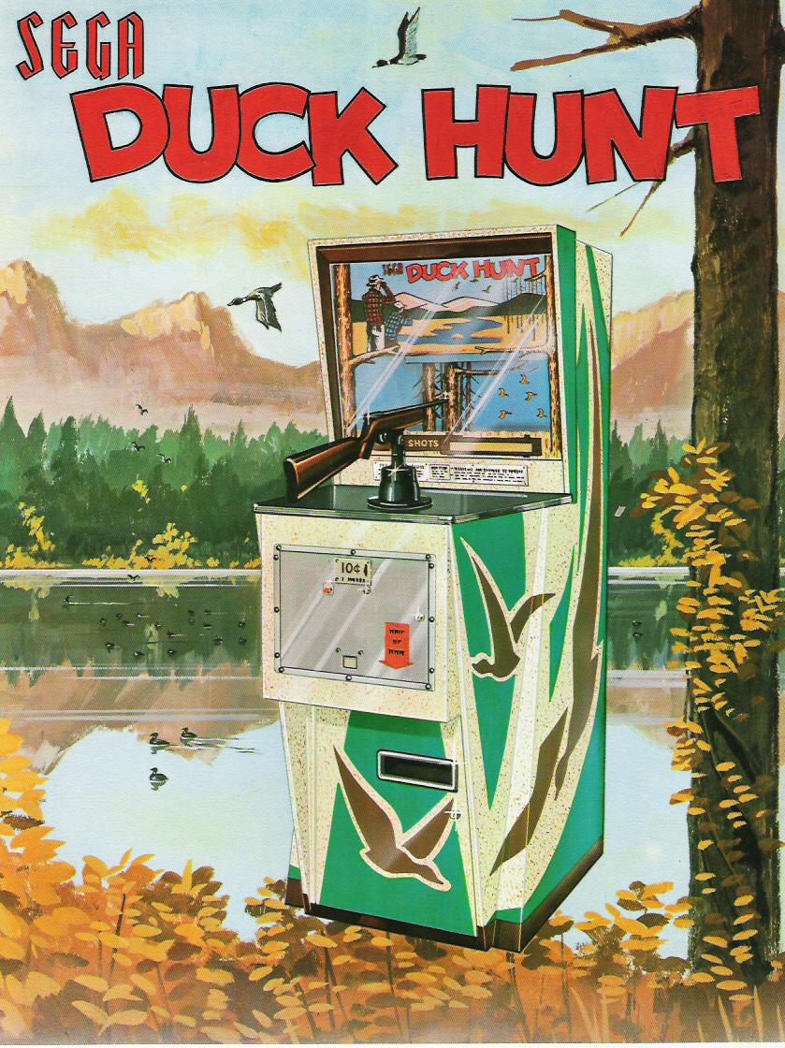
1969

Slide 20
History of Video Games Part 2
Magnavox Odyssey
link
link 2

Slide 21
History of Video Games Part 3
Pong, Space Wars, etc.
link

Slide 22
History of Video Games Part 4
Pong Wars
link

Slide 23
History of Video Games Part 5
Fairchild Channel F and Market Crash
link

Slide 24
Homework
http://hostos-gd201.tumblr.com
Download and install Game Maker
(via Steam or Yoyogames.com)
Read Ch2 of Trigger Happy
Play: Spacewar! - http://spacewar.overstigma.com
Pong - http://www.ponggame.org/
Adventure
http://www.web-adventures.org/cgi-bin/webfrotz?s=Adventure

Slide 25
Reading and Game Response 1 (RGR1): Write a thoughtful one to two page reflection after you have played the games and read the material. Topics to consider: What are some new things you learned? What are some lessons we can take away from the early days of the video game? Are these games still compelling?
link - http://bit.ly/1fTm5vJ

Slide 26
Next Class:
If the weather is nice, we will be doing an activity outside, so dress appropriately.

